Slide 1
C343 C++ Snakes and Ladders
Paul van Sittert
Aadil Sohail

Slide 2
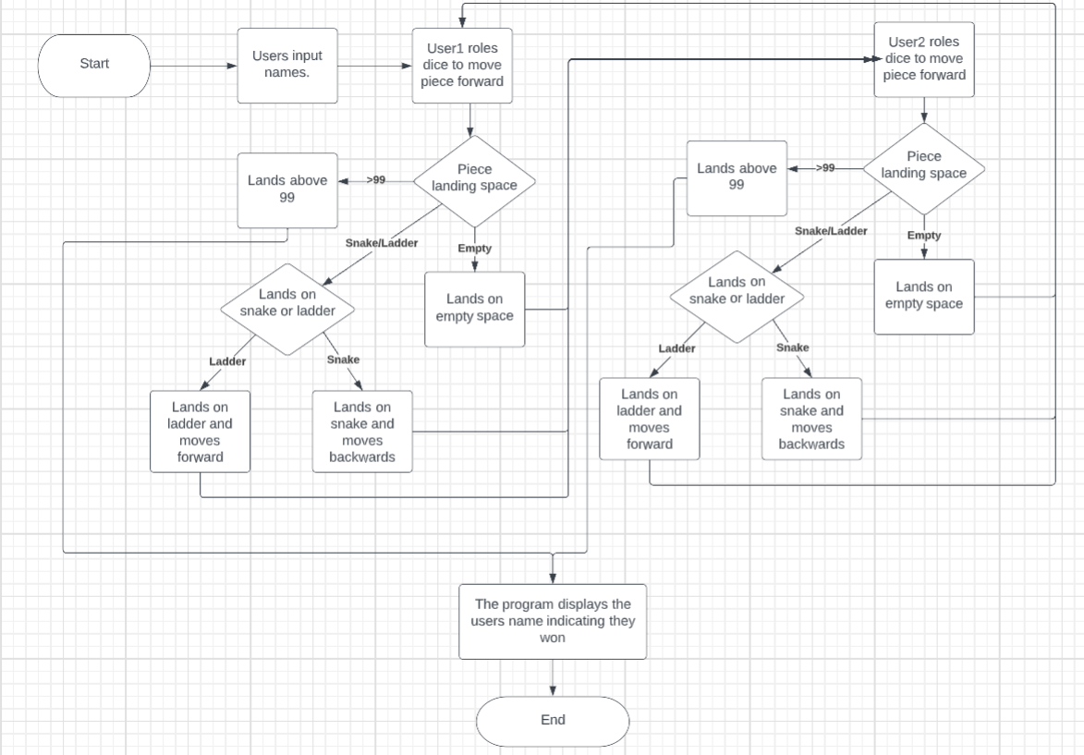
Flowchart
Notes:
This flowchart explains the main logic of the program. The users input their names then user1 would roll the dice.
Then the program goes through decision logic to determine weather the users piece landed on a snake, ladder, a normal space
or if they landed above 99 which means they won the game, in this scenario the program ends. In all the other scenarios the program
carries out the necessary processes depending on where the user landed and then user2 rolls the dice and the same decision logic and consequent processes repeat.
If again the game has not been won user1 rolls the dice; the program goes back and forth between the users in this manner until a winner is determined.
This is the original flowchart we created before creating the program of course we added some extra features however this still covers the core functionality of the program

Slide 3
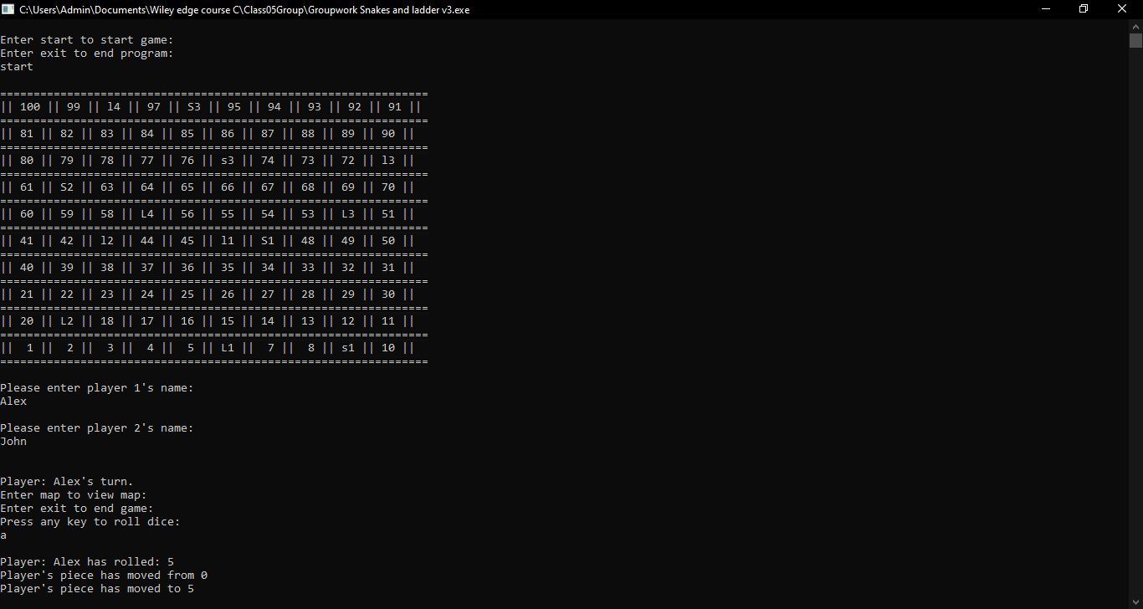
Program
Notes:
The start of the program as well as the main loop of the game.
When users start the program they are given a menu, to either start a game or exit the program.
Starting a new game loads in a map of the board and prompts users to enter names, which will be displayed throughout play.
Each player is then given a turn where they can roll the dice, view the map with updated positions or end the game.
Ending the game takes users back to the main menu to either start a new game or end the program.

Slide 4
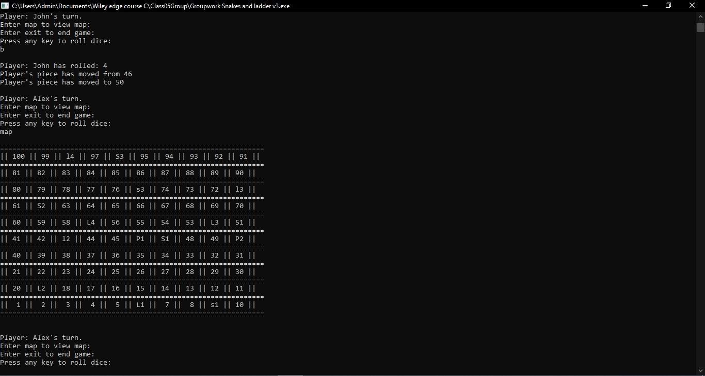
Program Map
Notes:
The user selects any button to roll the dice, Once the dice has been rolled the program informs the user what they rolled
and if they landed on any snakes or ladders further more it tells them what positions the snake/ladder takes them from and to,
finally the users new position is shown to the user. Before each roll the user has the option of typing 'map' to display the
current board, the different ladders are denoted by l1,l2,l3 and l4 with capitals (eg.L1) indicating where the ladder starts and
lowercase(e.g.. l1) indicating where the ladder takes you. The same semantics are applied for the snakes (s1,s2,s3...) with uppercase (e.g.. S1)
indicating the head of the snake and the lowercase (e.g.. s1) indicating what position the snake takes you down too (end of its tail).
Player position are denoted by 'P1' and 'P2' Respectively and in the scenario both player are on the same position the board will show 'PP' on that position

Slide 5
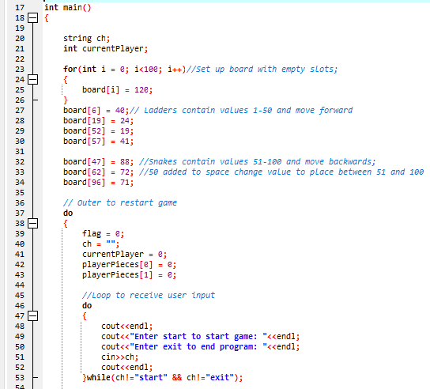
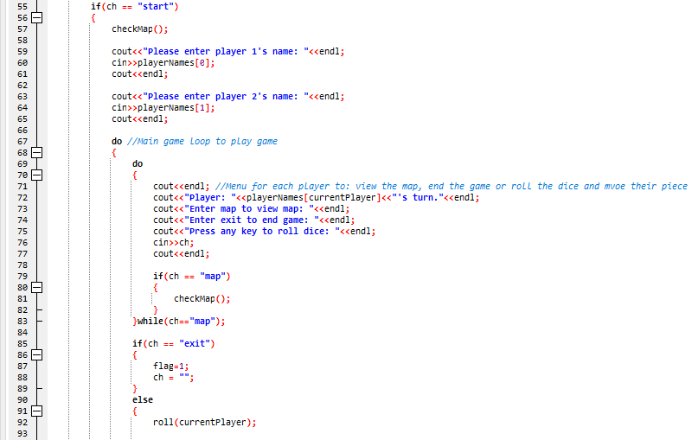
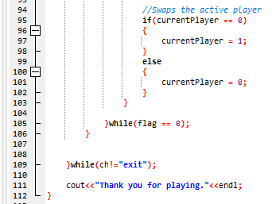
Main Loop
Notes:
The main loop of the program.
1:
We were tasked to simulate the board using a 1d char array, to do this we focused on using the code value stored in char and not a symbol value.
First it initializes the board, setting every space in the char array to 120, this value was used as a default empty space.
Then the positions of the bottoms of the ladders and heads of the snakes were loaded into the correct positions, with their values being 1-50 for ladders and 51-100 for snakes.
The values for ladders were the amount of spaces players would move forwards if they landed on them.
The values for snakes were the amount of spaces players would move backwards if they landed on them +50. This was to separate them from the ladder values.
Then the outer loop starts, setting up the player values, or clearing them if users just finished a game.
The outer loop then prompts the users to either start the game or end the program.
2:
If the users start the game, it loads in the map using the checkMap function.
The game ask the users to input names for both players which are saved and displayed throughout the game.
The main loop of the game then starts and it gives each user a turn where they make a choice. They can:
View the map again. Which loads the map, then gives users another menu to select the same choices.
End the game. Which exits the game loop and returns to the outer loop
Roll a dice. Which calls the roll function for the current player.
3:
After a user has rolled the dice, the game swaps the active player, ready for the next loop which will be the other players turn.
The program then contains the end condition for the game loop and the outer loop.
Finally once the outerloop is ended, the program displays a goodbye message before it ends.

Slide 6
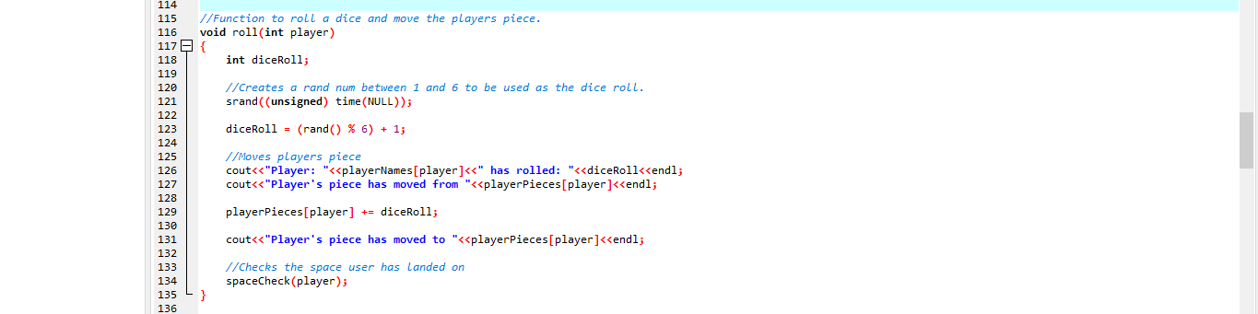
roll()
Notes:
The diceRoll function simulates the process of the user rolling a dice and moving their piece.
It makes us of rand function to generate a random number, uses the modulus function to divide the number by 6 to give a remainder between 0 and 5, then adds 1 to the number to give a random number between 1 and 6, simulating a dice roll.
The user piece is then moved by the spaces of the dice roll, before the spaceCheck function is called.

Slide 7
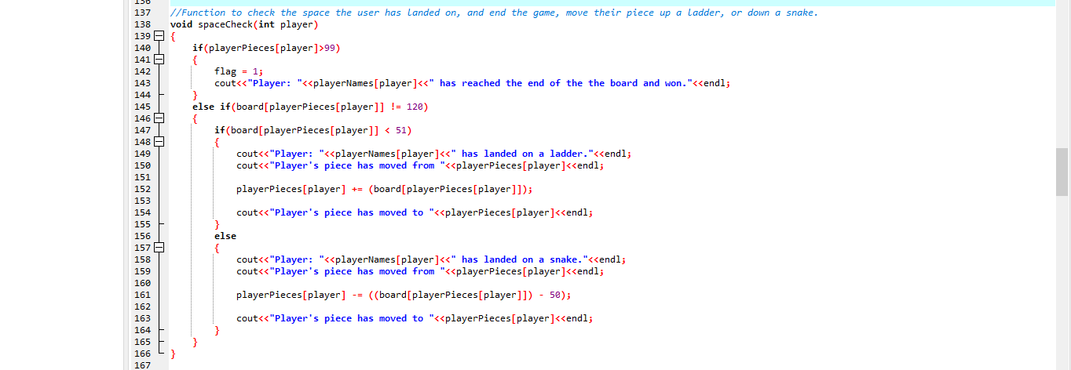
spaceCheck()
Notes:
The spaceCheck function checks what position the player has landed on and updates the board accordingly as well as informing the user of what's going on.
It takes in a variable player of type int which is the player number (0 or 1). if(playerPieces[player]>99) section is getting the value of playerPieces[player]
to check where the player if on the board and if this value is greater than 99 it means they have won the game so the flag variable is changed to 1
to indicate this a message is printed to the console informing the player they have won. Because we initialized all the board position as 120
we do else if(board[playerPieces[player]] != 120) as if the value is not 120 then it means its a snake or ladder. Inside the else if statement
if the player is piece is on a board position which is less than 51 (which represents ladders) we inform the player they landed on a ladder and where
they will end up we also update the playerPieces array to reflect the new position they are at now. If the value is not less than 51 and not 120 it must mean its > 51
so its a snake we do the same logical steps as the ladder but when we update the position we - 50 because we added 50 to all the snake values earlier.

Slide 8
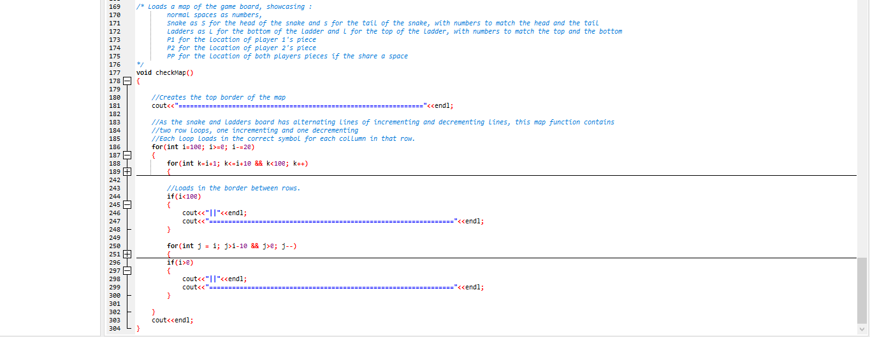
checkMap()
Notes:
The checkMap function displays the current map including the positions of snakes, ladders and players. The map contains alternating rows with the numbers
decrementing and incrementing; for this reason 2 loop were required in the larger for loop. The larger for loop represents the rows and would execute 5 times (because we start at 100 and decrement by 20 each iteration)
and because there are 2 for loops inside this loop we would get a total of 100 execution's by the end of the 5 iterations covering the whole board (as those k/j loops would execute 50 times).
For the k loop we only execute it when k<=i+10 && k<100 and we increment by 1 each time.
for the j loop we only execute when j>i-10 && j>0 and we decrement by 1 each time.
These conditions ensure that the loops execute on the correct rows (j -> the rows were the nums are descending and k-> the rows were the nums are ascending)
Within these inner loops the program checks the iterator against the location of the player’s pieces and loads in a P1 symbol for player 1, P2 for player 2 or PP if both players are on the same space.
The iterator is then checked against set values, loading in either the iterator value in empty squares, an S to represent a snake or L for a ladder.
If this program were to be taken further, the iterator would be compared against dynamic values holding the information about the snakes and ladders. But due to the static nature of the location
of the snakes and ladders in this program, we only compare them against set values.
The loops also created a border for each map square using “||“ between columns and ========== between rows.

